Slide 1
The Linux Command Line Chapter 11
The Environment
Prepared by Dr. Reyes, New York City College of Technology

Slide 2
The Environment
Environment: Information maintained by the shell during a particular session.
The system maintains this information using the following
Shell variables: variables used by the bash shell
Environment variables: all the other variables available in the system
Aliases: a command or a series of commands associated with a name (alias).
Shell functions: will be covered later

Slide 3

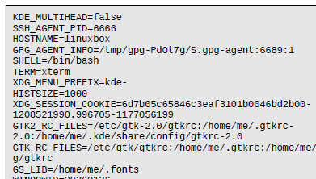
Display the Environment Variables
printenv – command used to display the environment variables
Result:

Slide 4


Display the value of a single variable
echo – command to display a string in the terminal
$ - use this sign in front of a variable to read its value
You can also use the command printenv followed by the name of the variable

Slide 5
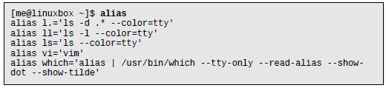
Alias Command
alias – used by itself, this command will display all the aliases in the environment

Slide 6
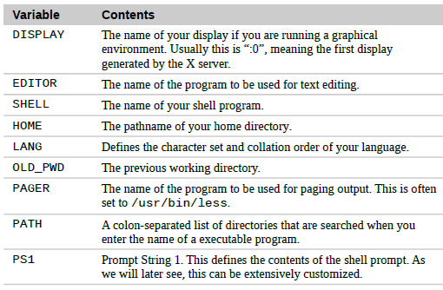
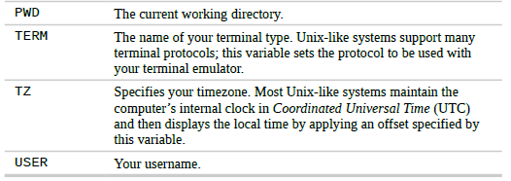
Some Interesting Variables

Slide 7
How Is The Environment Established?
When you log on to the system a series of files are read.
There are two types of sessions:
Login shell session – where you enter your username and password
Non-login session – when you start the terminal right away (guess session)

Slide 8
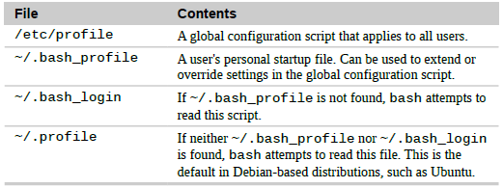

Files Read
For login shell session:
For non-login shell session:

Slide 9

How to Modify the Environment
In general you want to edit the most specific file such as .bashrc or .profile and then move up if necessary.
Strongly recommended to make a backup copy and add the changes to the bottom of the file
To apply the changes use the source command:

